Slide 1
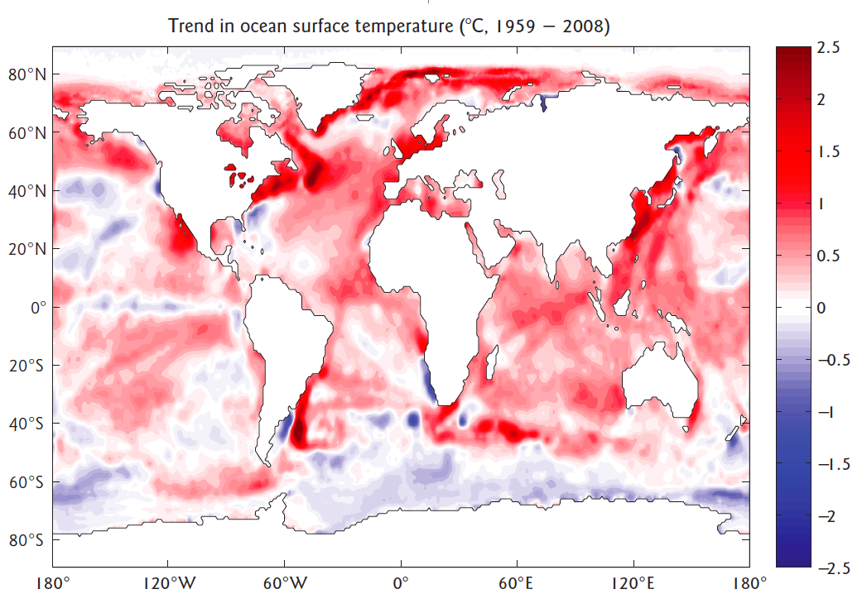
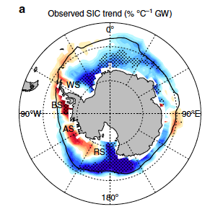


ACCESS model simulations of Antarctic sea-ice expansion and surface ocean cooling over the past four decades
Matthew England, Ariaan Purich, et al.
UNSW Sydney Australia
SST trends 1959–2008
Sea-ice trends 1979–2013
www.science.unsw.edu.au/~matthew
M.England@unsw.edu.au
ACCESS meeting September 7, 2017

Slide 2
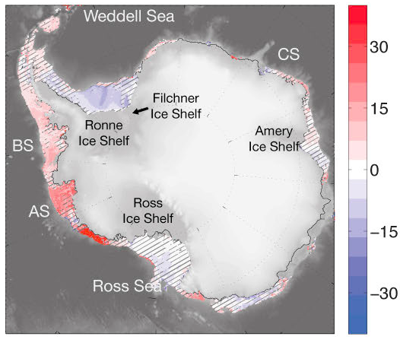
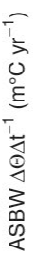
Project 2: Recent Antarctic shelf water trends
1975 – 2012
Trend in Antarctic Continental Shelf Bottom Water (ASBW).
(Shown at the seabed for depths <1500m
Schmidtko et al. 2014

Slide 3
ACCESS/COSIMA Project Tools
ACCESS-1.0 // ACCESS-1.3 // ACCESS-CM2
AusCOM like 1.0° global ocean-sea-ice model
Global coupled ¼ degree ACCESS-CM-0.25
Spence/MOM5 global ¼ degree ocean-ice model
COSIMA (ACCESS-OHD-0.1) ocean-ice model
Circumpolar ocean-ice shelf model
High-res regional sector models
CMIP5 and CMIP6 analysis and interpretations
1°
0.25°
0.1°
??°
1 – 3°

Slide 4
Factors affecting choice of model
Context of problem
Ocean-ice vs. Full coupled?
Resolution
Model biases
Established in the literature?
“Frozen” versions?
3-year PhD // postdoc time-scale

Slide 5
Ocean-atmosphere imprint of the Southern Annular Mode
Thompson et al. (2011)
Nature Geosciences
Sen Gupta and England (2006)

Slide 6
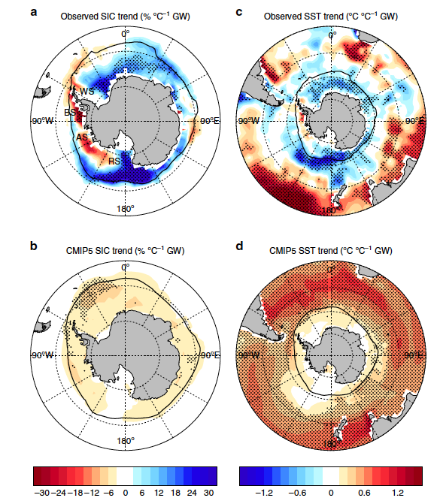
But MMM does not match OBS transient cooling
OBS
ICE
SST
Purich et al. (2016)
Nature Comms
MMM
ICE
SST

Slide 7
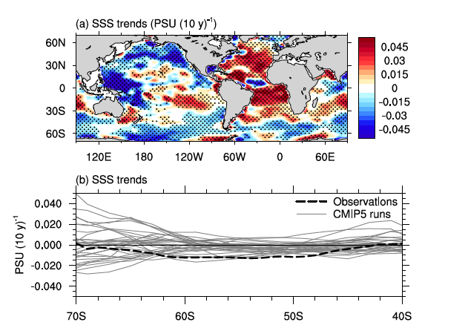
SSS trends over 1950–2000
(a) Durack and Wijffels (2010)
Purich, England et al. (2017)
J. Climate (submitted)
SSS trends 1950–2000

Slide 8
SSS trends over 1950–2000
(a) Durack and Wijffels (2010)
Purich, England et al. (2017)
J. Climate (submitted)
SSS trends 1950–2000

Slide 9
SSS trends over 1950–2000
(a) Durack and Wijffels (2010)
Purich, England et al. (2017)
J. Climate (submitted)
SSS trends 1950–2000

Slide 10
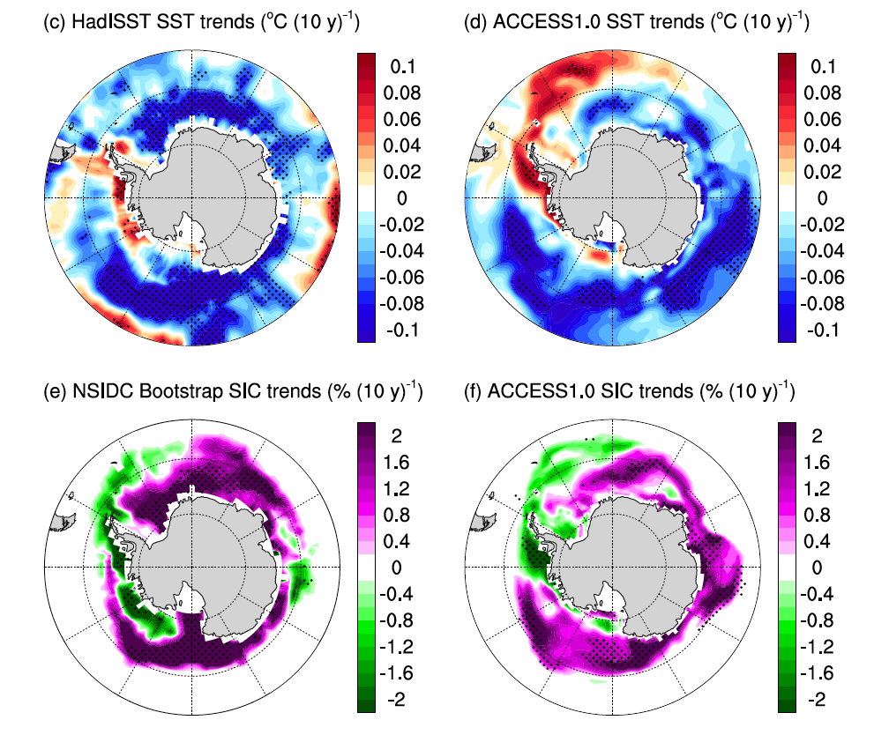
“Pacemaker” experiments with SO SSS restored to OBS
OBSERVED
MODEL
SST
SST
ICE
ICE
Purich, England et al. (2017)

Slide 11
Variability is also playing a significant role….
SST and MSLP trends over 1979–2013.
Purich et al. (2016)
Journal of Climate

Slide 12
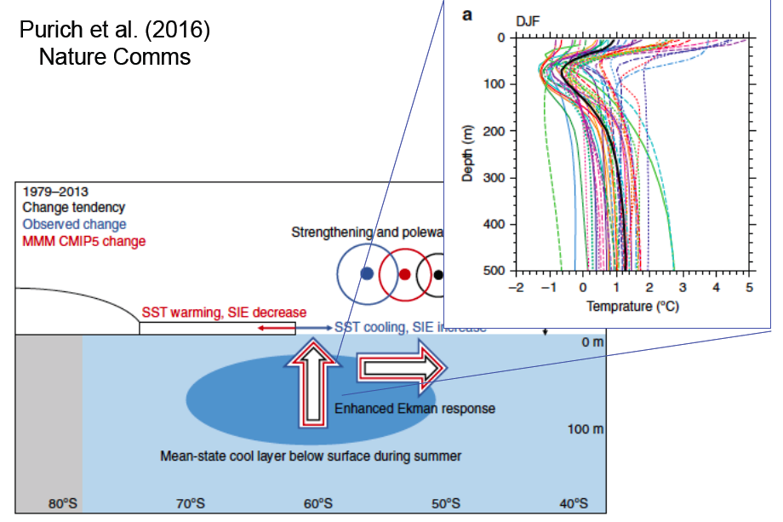
Why do models “miss” the cooling?
Model biases in the midlatitude jet and interior temperature structure
Missing freshening over the surface Southern Ocean – perhaps due to cloud / precipitation biases…?
Interannual – decadal variability is also a significant player, via the IPO / ENSO / Atlantic
SSS trends 1950–2000

Slide 13
ACCESS model simulations of Antarctic sea-ice expansion and surface ocean cooling over the past four decades
Matthew England, Ariaan Purich, et al.
UNSW Sydney Australia
SST trends 1959–2008
Sea-ice trends 1979–2013
www.science.unsw.edu.au/~matthew
M.England@unsw.edu.au
ACCESS meeting September 7, 2017

Slide 14
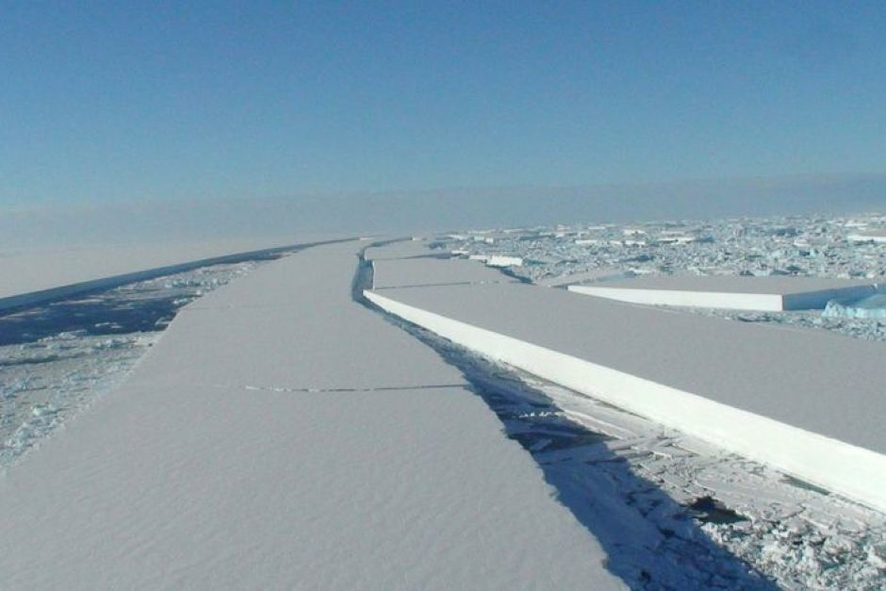
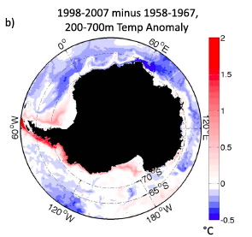
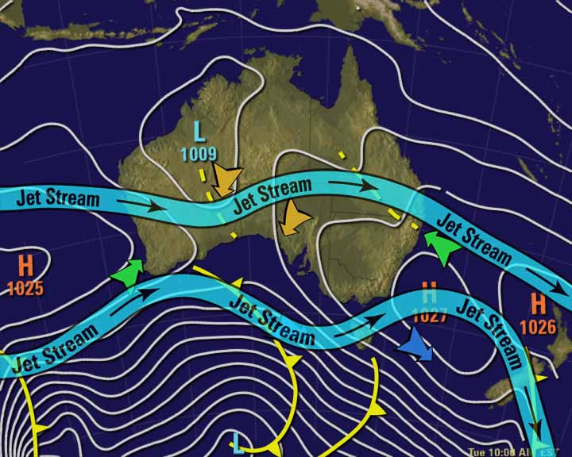
Mechanism for circulation changes and
rapid warming in the Southern Ocean
Spence et al. GRL 2014
Spence et al. NCC 2017

Slide 15
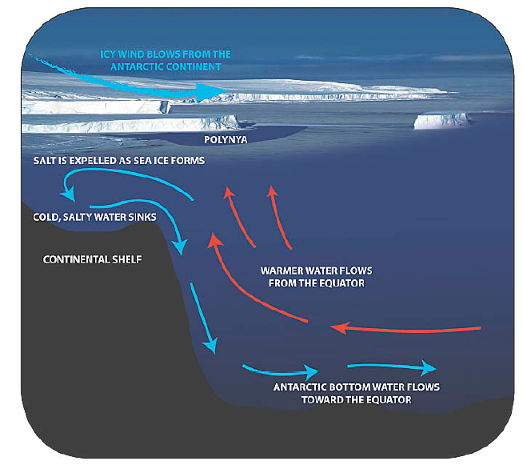
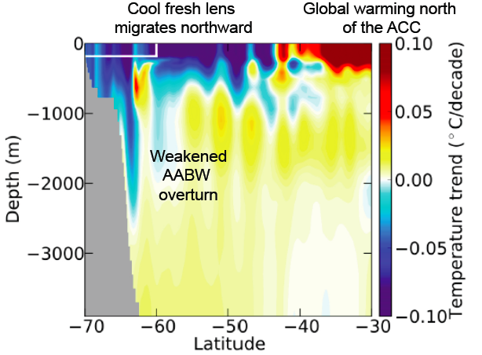
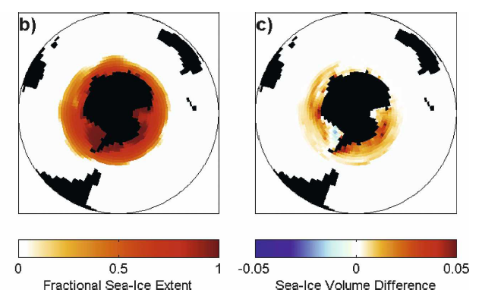
Adding FW anomalies also has a cooling effect
CTRL sea-ice
FW+ minus CTRL
Morrison et al. (2013)
FRESHENING -> COOLING
Aiken and England (2008)
Aiken and England (2008)
See also: Swart and Fyfe (2013)
Bintanja et al. (2013)

